Slide 1


WELCOME
Introduction from Mental Health Support Team (MHST)
Notes:
Hi – my name is Tanya Stilwell and I am a Trainee Educational Mental Health Practitioner. The purpose of this PPT is to introduce myself, my role and my wider team, and let you know the support that we are offering to your school.
I am introducing myself in this format due to Covid 19 restrictions but I am really hoping that I shall be able to meet you all in person very soon. The PPT will take around 20 mins to watch, and there will be a chance to ask me questions and offer feedback at the end.

Slide 2

Mental Health Support Team
The PLYMOUTH team
Livewell has a Mental Health Support Team made up of Educational Mental Health Practitioners (EMHP’s) and support workers, who are working across the city.
EMHPs are employed by Livewell Southwest and are supported and connected to the wider mental health support in the city.
Support offered by Educational Mental Health Practitioners includes:
One to one Low Intensity Cognitive Behavioural Therapy sessions with children and young people (CYP) 5-18 years
Group psychoeducation sessions for CYP on mental health and emotional wellbeing
Staff training on mental health and wellbeing
Support for schools in adopting a whole school approach to mental health, including a supported audit of wellbeing needs
Staff consultation offer
Support to set up and run peer mentoring groups
Notes:
Livewell MHST is training four Educational Mental Health Practitioners who are working across the city. EMHPs are employed by Livewell Southwest and are supported and connected to the wider mental health support in the city.
Support offered by Educational Mental Health Practitioners includes:
One to one Low Intensity Cognitive Behavioural Therapy sessions with children and young people 5-18 years
Group psychoeducation sessions for CYP on mental health and emotional wellbeing
Staff training on mental health and wellbeing
Support for schools in adopting a whole school approach to mental health, including a supported audit of wellbeing needs
Staff consultation offer
Support to set up and run peer mentoring groups

Slide 3
The rationale for mental health support in school
In 2017, the government published the response to the Children and young People’s Mental Health Green Paper.
It set out 3 key elements to transform mental health services for children:
To incentivise and support all schools and colleges to identify and train a Designated Senior Lead for Mental Health.
To fund new Mental Health Support Teams.
Trial a four week waiting time for access to specialist NHS children and young people’s mental health services.

Slide 4
The rationale for mental health support in school
Future in Mind Report 2015
1 in 10 children need treatment for mental health problems
Mental health problems result in lower educational attainment (e.g. children with conduct disorder are twice as likely as other children to leave school with no qualifications)
MH problems are strongly associated with behaviours that pose a risk to health (e.g. smoking, drug and alcohol abuse and risky sexual behaviour).
- 75% of mental health problems in adult life start by the age of 18.
Notes:
A little more context on the rationale – The Future in Mind report of 2015 identified that 1 in 10 children needed help for mh conditions, mental health problems result in lower educational attainment (e.g. children with conduct disorder are twice as likely to leave school with no qualifications, mh problems are strongly associated with behaviours that pose a risk to health (i.e., smoking, drug and alcohol abuse and risky sexual behaviours), 75 per cent of mh problems in adults start by the age of 18

Slide 5





cognitive behavioural therapy (CBT)?
As within the adult IAPT (Improving Access to Psychological Therapies) model, low-intensity level, cognitive-behavioural approaches are recommended in NICE guidelines for the treatment of many disorders.
This evidence base of LI CBT approach is steadily growing for the early help and prevention treatment for psychological disorders in CYPs.
Autonomic symptoms
Behaviours
Cognitions
Emotions
Aims to interrupt the vicious cycle by targeting one or more ABC area
Notes:
So, what is cognitive behavioural therapy?
In adult IAPT, at a low-intensity level, cognitive-behavioural approaches are recommended in NICE guidelines for the treatment of many disorders.
The evidence base for CBT as a treatment approach for psychological disorders in CYPs is steadily growing
CBT works to identify these elements where problems occur in a given situation – the thoughts that a person is having (cognitions),the emotions they are feeling, the bodily sensations (autonomics) , the resulting behaviours. CBT aims to interrupt the vicious cause and effect cycle by targeting one of these areas with precise interventions, and to engender a positive and helpful cycle.

Slide 6
cognitive behavioural therapy (CBT)?
Tired
Difficulty sleeping
Difficulty concentrating
Autonomic symptoms
Behaviours
Cognitions
Emotions
Stop doing things
Not seeing friends
Snapping at people
Staying in bed longer
Eating more or less
Sad
Low
“What’s the point?
“I’m a failure”
“Nobody likes me”
Notes:
So, what is cognitive behavioural therapy?
In adult IAPT, at a low-intensity level, cognitive-behavioural approaches are recommended in NICE guidelines for the treatment of many disorders.
The evidence base for CBT as a treatment approach for psychological disorders in CYPs is steadily growing
CBT works to identify these elements where problems occur in a given situation – the thoughts that a person is having (cognitions),the emotions they are feeling, the bodily sensations (autonomics) , the resulting behaviours. CBT aims to interrupt the vicious cause and effect cycle by targeting one of these areas with precise interventions, and to engender a positive and helpful cycle.

Slide 7
cognitive behavioural therapy (CBT)?
Tired
Difficulty sleeping
Difficulty concentrating
Autonomic symptoms
Behaviours
Cognitions
Emotions
Sad
Low
Stop doing things
Not seeing friends
Snapping at people
Staying in bed longer
Eating more or less
“What’s the point?
“I’m a failure”
“Nobody likes me”
Notes:
So, what is cognitive behavioural therapy?
In adult IAPT, at a low-intensity level, cognitive-behavioural approaches are recommended in NICE guidelines for the treatment of many disorders.
The evidence base for CBT as a treatment approach for psychological disorders in CYPs is steadily growing
CBT works to identify these elements where problems occur in a given situation – the thoughts that a person is having (cognitions),the emotions they are feeling, the bodily sensations (autonomics) , the resulting behaviours. CBT aims to interrupt the vicious cause and effect cycle by targeting one of these areas with precise interventions, and to engender a positive and helpful cycle.

Slide 8
low intensity cbt for cyp
Depression
Behavioural Experiments
Cognitive Restructuring
Agoraphobia
OCD
Exposure Habituation
Cognitive Restructuring
Behavioural Experiments
Exposure Response Prevention
GAD
Worry Management
Social Phobia / Health Anxiety
Behavioural Experiments
Exposure Habituation
Cognitive Restructuring
Phobia
Behavioural Experiments
Exposure Habituation
Cognitive Restructuring
Behavioural difficulties
Parenting interventions
Behavioural Activation
Cognitive Restructuring
Behavioural Experiments
Panic
Anxiety
Coping Cat
Pesky gNATs
Parent-led CBT
Pesky gNATs
Notes:
I am showing you this slide as it basically details the types of intervention that we offer at low intensity. Low intensity cbt aims to sit below the camhs threshold and to target emerging problems and offer early intervention.
Low intensity cbt is recommended to help with depression, anxiety including generalised anxiety disorder (GAD), panic, agoraphobia, OCD (but only when the symptoms are taking up less than an hour a day of the yp time, social phobia and health anxiety, specific phobias such as fear of dogs etc, and behavioural difficulties with younger age children for which we offer a parenting intervention.
Adolescents and older primary age children may work with us 1:1, with younger children we will usually work with the parent as well, its up to families and individuals to decide what works for them. Sessions will usually run for 8 – 1o weeks and last around a hour at a time, and can be carried out in school and in school time, as well as at cyp homes at times

Slide 9
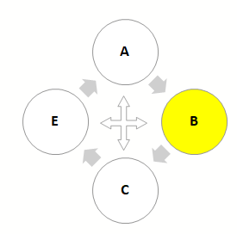
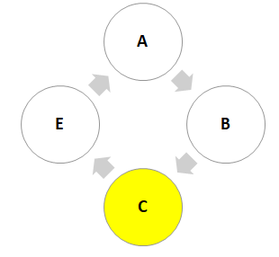
low intensity cbt for cyp
Exposure & Habituation
Agoraphobia, Panic, specific phobia, social phobia and health anxiety
Behavioural Activation
Low Mood
Cognitive Restructuring
Panic, depression, agoraphobia, social phobia, health anxiety, specific phobia
Exposure and Response Prevention
Obsessive Compulsive Disorder
Worry management
Generalised anxiety disorder
Notes:
I am showing you this slide as it basically details the types of intervention that we offer at low intensity. Low intensity cbt aims to sit below the camhs threshold and to target emerging problems and offer early intervention.
Low intensity cbt is recommended to help with depression, anxiety including generalised anxiety disorder (GAD), panic, agoraphobia, OCD (but only when the symptoms are taking up less than an hour a day of the yp time, social phobia and health anxiety, specific phobias such as fear of dogs etc, and behavioural difficulties with younger age children for which we offer a parenting intervention.
Adolescents and older primary age children may work with us 1:1, with younger children we will usually work with the parent as well, its up to families and individuals to decide what works for them. Sessions will usually run for 8 – 1o weeks and last around a hour at a time, and can be carried out in school and in school time, as well as at cyp homes at times

Slide 10
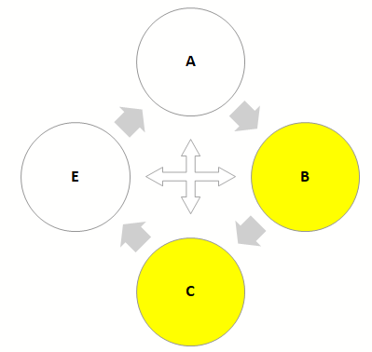
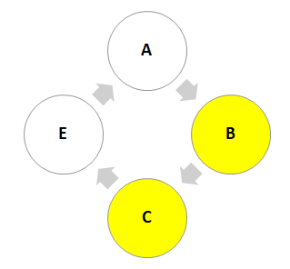
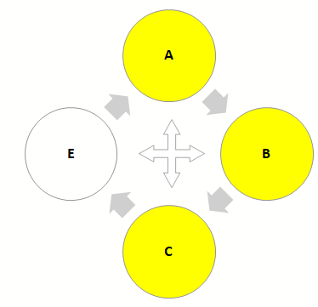
low intensity cbt for cyp
Parent-led CBT
Anxiety
Behavioural Experiments
Social phobia, phobia, panic, depression, agoraphobia, health anxiety
Coping Cat
Anxiety difficulties.
Pesky gNATs
Low mood and anxiety
Notes:
I am showing you this slide as it basically details the types of intervention that we offer at low intensity. Low intensity cbt aims to sit below the camhs threshold and to target emerging problems and offer early intervention.
Low intensity cbt is recommended to help with depression, anxiety including generalised anxiety disorder (GAD), panic, agoraphobia, OCD (but only when the symptoms are taking up less than an hour a day of the yp time, social phobia and health anxiety, specific phobias such as fear of dogs etc, and behavioural difficulties with younger age children for which we offer a parenting intervention.
Adolescents and older primary age children may work with us 1:1, with younger children we will usually work with the parent as well, its up to families and individuals to decide what works for them. Sessions will usually run for 8 – 1o weeks and last around a hour at a time, and can be carried out in school and in school time, as well as at cyp homes at times

Slide 11
Key components of cbt with children:
Key components of low intensity cognitive behavioural therapy for children and young people:
Assessment (finding out what the difficulties are).
Formulation / Shared Understanding (shared understanding of how to make sense of their difficulties and what is keeping them going).
Goal setting (deciding on joint goals that the young person and the therapist will work on).
Psycho-education (giving the young person information that helps them make sense of what is going on and shows them they are not alone).
Planned interventions (testing out new behaviours or new ways of thinking about situations).
Relapse prevention (pulling all the learning from therapy together and making a ‘set back plan’ to help the young person deal with things in the future if they get a bit difficult again).
Notes:
Key components of low intensity cognitive behavioural therapy for children and young people:
Assessment (finding out what the difficulties are).
Formulation / Shared Understanding (shared understanding of how to make sense of their difficulties and what is keeping them going).
Goal setting (deciding on joint goals that the young person and the therapist will work on).
Psycho-education (giving the young person information that helps them make sense of what is going on and shows them they are not alone).
Planned interventions (testing out new behaviours or new ways of thinking about situations).
Relapse prevention (pulling all the learning from therapy together and making a ‘set back plan’ to help the young person deal with things in the future if they get a bit difficult again).

Slide 12
Group psychoeducation and peer mentoring
Psychoeducational Groups:
Designed to offer education and support to groups of young people who struggle with the same difficulties, and offer a sound basis for CBT. Children may attend one of these groups before going on to 1:1 therapy.
Usually for groups of 8-12 young people.
Subjects might include: Understanding and Managing Low Mood, Understanding and Managing Anxiety, Exam Stress, Body Image and the Media, Your Teenage Brain and how to manage your wellbeing.
Peer Mentoring:
The peer mentoring programme aims to support emotional resilience in young people.
Offers a 10 week course for 8-12 young people centred around training mental health peers and offering support and mentorship to younger children at the school.
Notes:
Psychoeducational Groups:
Designed to offer education and support to groups of young people who struggle with the same difficulties, and offer a sound basis for CBT. Children may attend one of these groups before going on to 1:1 therapy.
Usually for groups of 8-12 young people.
Subjects might include: Understanding and Managing Low Mood, Understanding and Managing Anxiety, Exam Stress, Body Image and the Media, Your Teenage Brain and how to manage your wellbeing.
Peer Mentoring:
The peer mentoring programme aims to support emotional resilience in young people.
Offers a 10 week course for 8-12 young people centred around training mental health peers and offering support and mentorship to younger children at the school

Slide 13
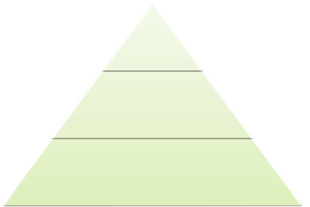
WHOLE SCHOOL APPROACH
“A whole school approach is cohesive, collective and collaborative action in and by a school community that has been strategically constructed to improve student learning, behaviour and wellbeing, and the conditions that support these”.
Department of Education Western Australia (2009)
The National Institute for Health and Care Excellence (NICE) advises that primary schools and secondary schools should be supported to adopt a comprehensive, ‘whole school’ approach to promoting the social and emotional wellbeing of children and young people (Social and emotional wellbeing for children and young people overview - NICE Pathways).
This approach moves beyond learning and teaching to pervade all aspects of the life of a school or college and has been found to be effective in bringing about and sustaining health benefits.
CEDAR 2022
Step Up
Refer up, link with multiagency teams
1:1 work, parent led, targeted PEG, peer mentoring, training school staff, staff consultation
Targeted Support
Universal Interventions
Universal PEG, training school staff, staff consultation, most of WSA

Slide 14
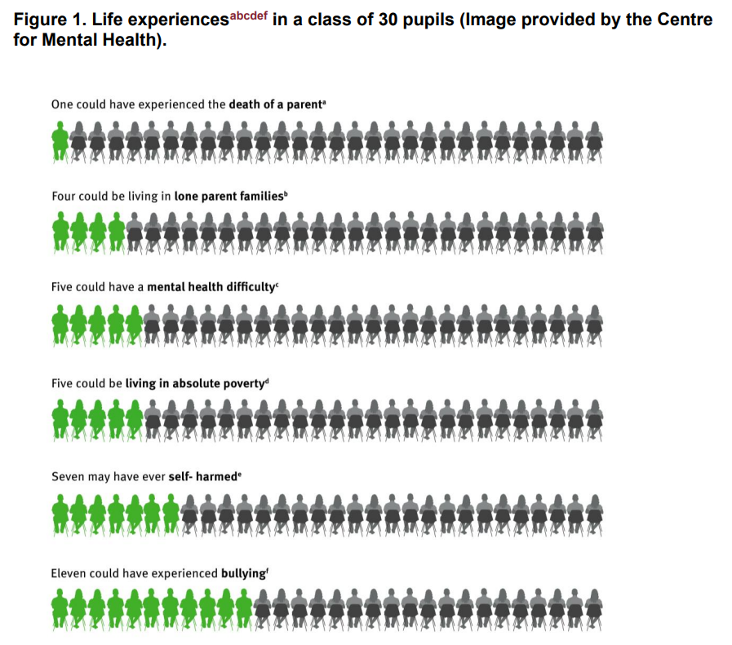
WHOLE SCHOOL APPROACH
Research :
Whole school approach can improve attendance and attainment – so as levels of mental health difficulties increase attainment results decrease.
Whole school approaches have better, longer lasting outcomes than approaches that focuses on one or two aspects of school life (Adi et al., 2007; Weare & Nind, 2011).
Staff feel more knowledgeable and better equipped to respond effectively when they have had support to understand risk factors associated with problem development.

Slide 15
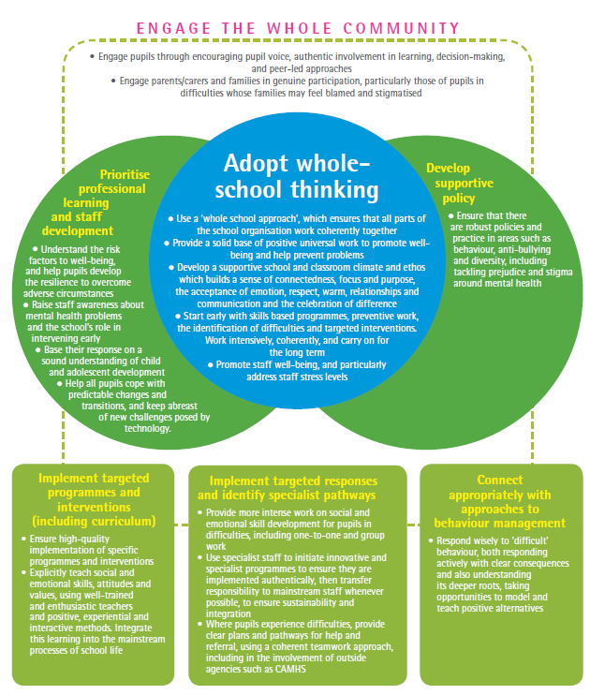
WHOLE SCHOOL APPROACH
  What we can offer:
  One to One LI CBT Interventions
  Staff Training
  Staff Consultation
  Psychoeducational Workshops
  Targeted psychoeducational Workshops/Group Work
  Pupil Drop –in sessions ( older children
  Peer mentoring
  Parent psychoeducation
  Parent drop- in sessions

Slide 16
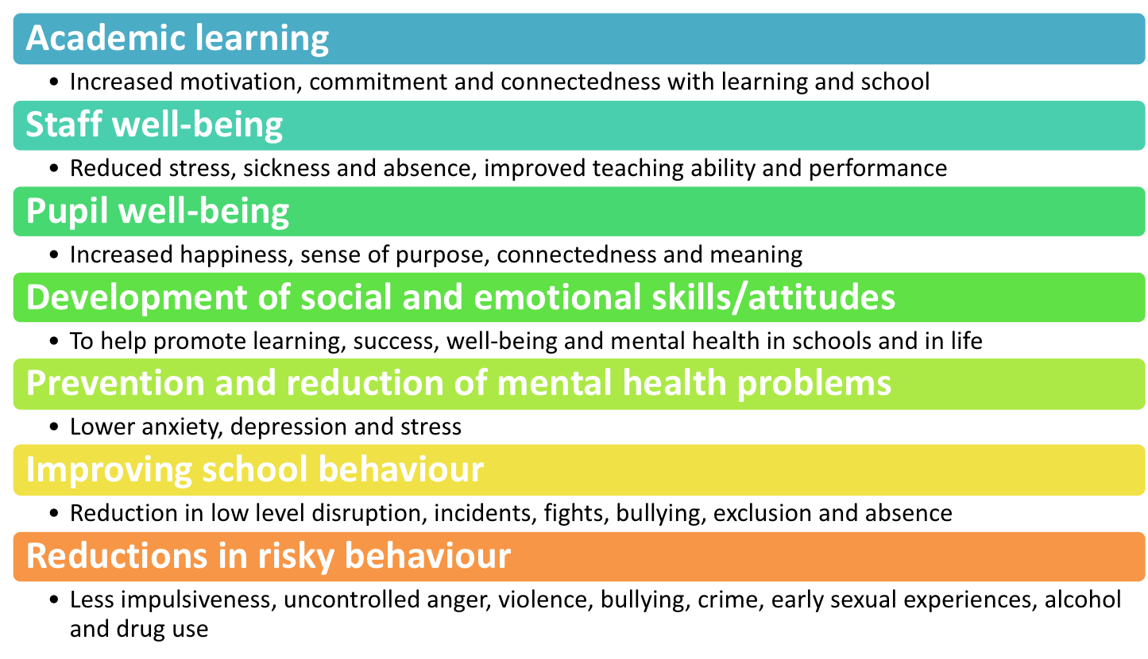
WHOLE SCHOOL APPROACH
CEDAR 2022

Slide 17
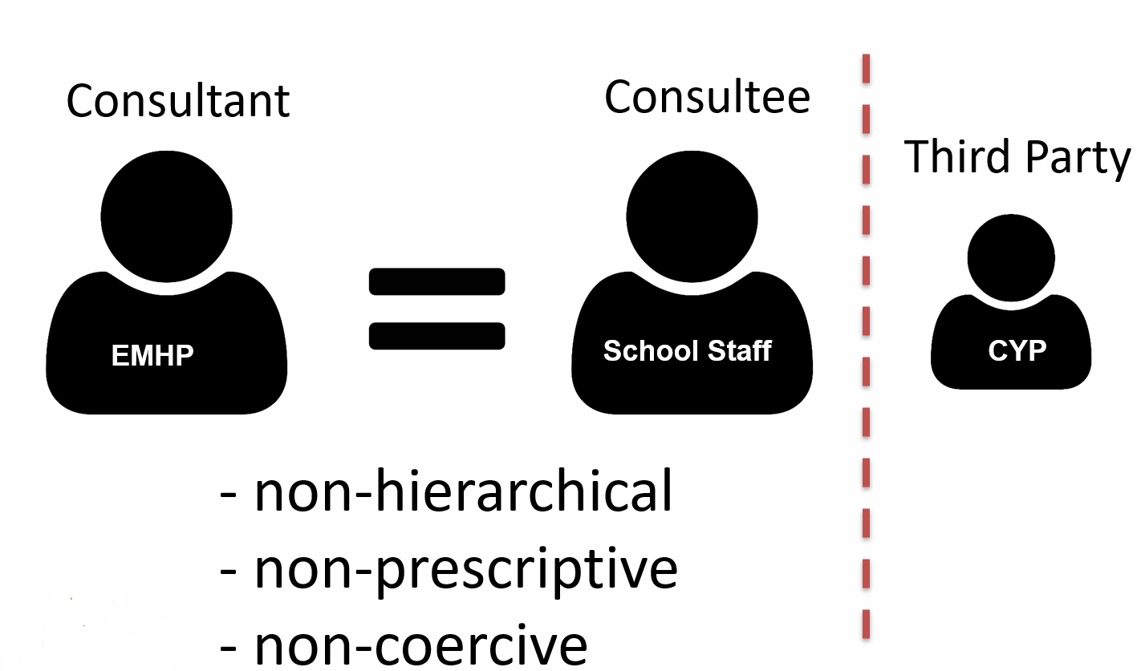
STAFF CONSULTATION
Consultation is the opportunity to talk through any mental health related concerns which you may have regarding a young person who attends the school in which you work, and is open to all staff members at the school. The sessions are confidential, unless risk is disclosed and this will be explained further within the session. We do ask that you anonymise any child information.
Sessions are usually between 20-40 minutes long. An example question to bring could be ‘A girl in my class is very quiet and isolated. I don’t know how to help her.’ Within consultation we won’t ‘tell’ you what to do, but instead we will aim to collaboratively find a solution or find out where you could gain further support.
Caplan CCC Model
Notes:
Consultation is the opportunity to talk through any mental health related concerns which you may have regarding a young person who attends the school in which you work, and is open to all staff members at the school. The sessions are confidential, unless risk is disclosed and this will be explained further within the session. We do ask that you anonymise any child information.
Sessions are usually between 20-40 minutes long. An example question to bring could be ‘A girl in my class is very quiet and isolated. I don’t know how to help her.’ Within consultation we won’t ‘tell’ you what to do, but instead we will aim to collaboratively find a solution or find out where you could gain further support.

Slide 18

Staff training
Your Educational Mental Health Practitioner can also offer short staff training sessions on child and adolescent mental health and wellbeing.
Sessions could be on subjects such as:
Common Mental Health problems in children and how to recognise them
Low Mood – what it looks like in children and how CBT can help
Anxiety – what it looks like in children and how CBT can help
The Adolescent Brain - and how it affects them in school
Notes:
We also offer short staff training sessions on child and adolescent mental health and wellbeing.
Sessions could be on subjects such as:
Common Mental Health problems in children and how to recognise them
Low Mood – what it looks like in children and how CBT can help
Anxiety – what it looks like in children and how CBT can help
The Adolescent Brain - and how it affects them in school

Slide 19
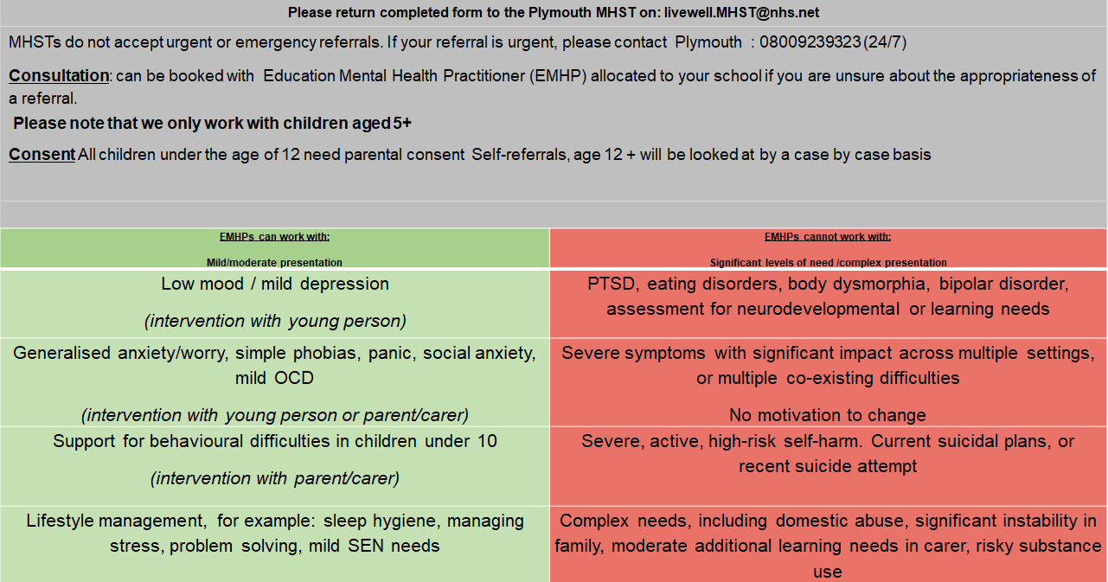
MHST THRESHOLD

Slide 20
referrals
Referrals for individual children and families will normally be made through your SENCO or MH Lead.
Referrals can be made by the families themselves.
For more information, and details on how to refer, follow this link
Alternatively, you can get in touch with the team by emailing livewell.MHST@nhs.net

Slide 21


A MESSAGE FROM THE TEAM
Despite the challenges of the last 18 months the Plymouth MHST is proud of what we have already achieved and what we hope to continue to do. We are committed to supporting, children, families and schools, and have some exciting plans to continue to develop our offer to families and schools going forward, as well as our new trainees and support workers to add to our amazing team.
Through supporting each other and the people we work with, we have strived to improve mental health and wellbeing especially throughout the period of COVID and lockdown. We now are looking forward to continuing our journey with you all.
Many Thanks Plymouth MHST

