Slide 1

Meet the Teacher 2023
Year 4, Badger Class.

Slide 2
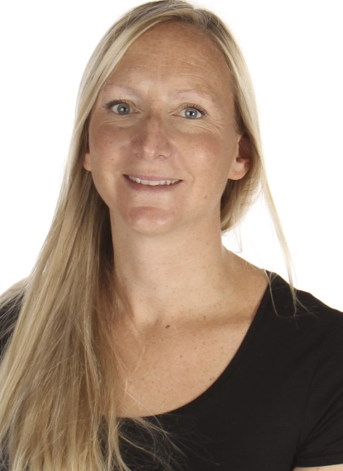
Who’s Who?
Mrs Booth - Badger Class Teacher
Mrs Walters - Teaching Assistant
Mrs Chantler – PPA Teacher (Tuesday all day)

Slide 3
Supporting Children with Special Needs
We strive to be a fully inclusive school and provide children with support to overcome any barriers to their learning.
Class teachers will communicate regularly with parents to identify and discuss support for children with Special Educational Needs.
Mr Peter Grafton is our Special Educational Needs and Disabilities Coordinator, he works in school on a Monday.
The school follows both Devon and Plymouth pathways for identifying and supporting children with SEND. Please ask your child’s teacher or SENDCO about this.
Please see the school’s website ‘Key Information’ for the SEND policy and further websites to support.

Slide 4
Working Together
We will invite you to come and talk to us if your child is frequently having difficulty following class and school rules, so that we can work together to improve the situation. This will ensure a successful learning experience for your child and others in the class
Also, if there is anything that is worrying your child, please let us know as soon as possible so that we can support appropriately.
Any worries, queries – please feel free to ask the office for a chat/appointment time (after school is better unless it is urgent) – we also have systems whereby we can message you all with school information (ClassDojo or Teachers2Parents).

Slide 5
School/Class Expectations
Behaviour
In line with the school Behaviour Policy
Focus on the positive.
Catch Me rules agreed with the children so they are safe and learning is maximised and enjoyable for all!
Rewards vary and include certificates, Catch Me Star of the week, Dojo rewards, golden time, house points, class rewards, raffles etc.

Slide 6
Class Homework Arrangements
Set on Wednesday and due following Wednesday.
Daily reading.
NumBots, TTRockstars, Spellings.
We may include additional homework through the term to reinforce class learning.

Slide 7
How can you help your child?
Support him/her with their homework
Listen to your child read/share a book/talk about
what you have read together/ask lots of questions to
develop comprehension
Build Regular times table facts and mental maths – TTRockstar Maths - NumBots play lots of related games/quizzes www.multiplication.com
Build Self-esteem- confident children make
successful learners
Check school bags - ensure permission slips, information & data forms are returned and up-to-date
Inform us of any changes in home circumstances

Slide 8
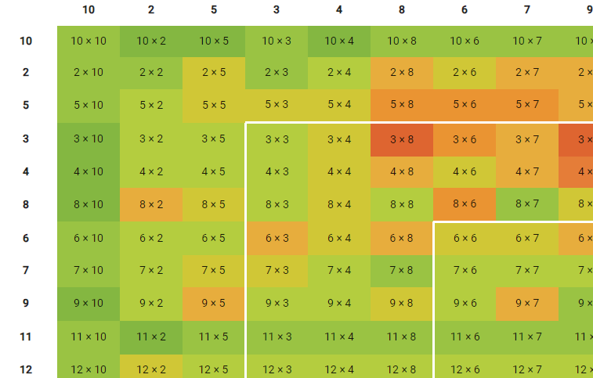
How can you help your child?
The multiplication tables check (MTC) is statutory for all year 4 pupils registered at state-funded maintained schools, special schools or academies (including free schools) in England.
It is an on-screen check consisting of 25 times table questions. Your child will
be able to answer 3 practice questions before taking the actual check. They will
then have 6 seconds to answer each question. On average, the check should
take no longer than 5 minutes to complete
The purpose of the MTC is to determine whether pupils can recall their times tables fluently up to 12’s, which is essential for future success in mathematics. It will help schools to identify pupils who have not yet mastered their times tables, so that additional support can be provided.

Slide 9
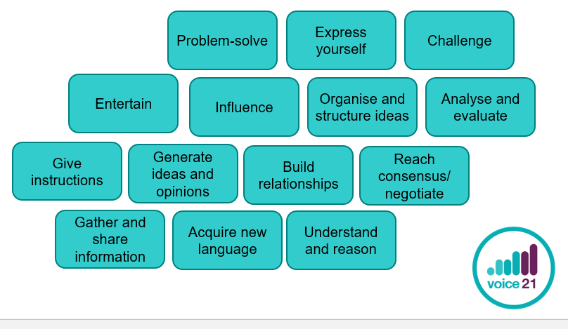
Oracy: the ability to express one’s self fluently and grammatically in speech

Slide 10
General Information & Reminders

Slide 11

Snacks and/or Packed Lunches
Please could you make sure that your child brings a healthy snack for break time, such as a piece of fruit, crackers or a healthy snack bar.
Packed lunches should be healthy too. Please provide an adequate amount, appropriate to your child’s needs.

Slide 12
PE Kits
Kits need to be in school every day. PE days are now a Monday and Friday (coach)
Plimsolls and/or trainers
Tracksuit or jogging bottoms for winter (to wear over school kit), shorts.
Please make sure that everything is named
Long hair should be tied up and earrings should be removed, or micropore tape provided from home, please
If any reasons your child cannot take part, please inform us by letter or a telephone call – we will send a note home if pupils don’t have correct kit in school as they cannot participate without it (H&S)

Slide 13
School Times
start time of 8.45am and end time of 3.15pm for ALL children (The school operates a Breakfast Club from 7.30-8.45am for those parents requiring early morning child care. Please see website for costs.)
The Back gate will be locked for security at the end of the normal school day. Please walk around and pick up children from the Main Entrance for any clubs

Slide 14
General Information
The school operates an open door policy – the best time is after school as staff are getting organised for the day’s learning
Email admin if you have any problems and you can’t pop in
admin@sherfordvaleschool.co.uk
Or – you can message your child’s class teacher through ClassDojo (Please be aware that these will be monitored regularly but this does not mean you will get an immediate reply, it may be the following day, or, if over a weekend, the next working day)
The school will offer 3 formal parents’ evenings – one each term (The summer term is offered after receipt of your child’ annual report)

Slide 15

Curriculum
Maths and English daily.
Geography, RE and History using Opening Worlds Curriculum. More information on the website to follow.
Art and DT on a 6 week, half term basis.
Science weekly.
PE twice a week.
PSHE, Emotional Logic, Spanish, Music weekly.

Slide 16

Thank you for coming – it has been so lovely to invite parents and carers in again and to begin re-building the community!
We are looking forward to a fantastic year with our fabulous
Badger class!
Do you have any questions?

