Slide 1

Meet the Teacher 2026
Year 6 – Owl Class

Slide 2
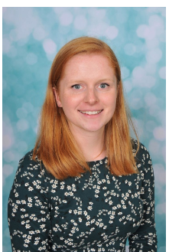
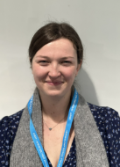
Who’s Who?
Mrs Nuttall – Class Teacher
Mrs Cullen – Class Teaching Assistant
Mrs Hooper – Student Teacher

Slide 3
Supporting Children with Special Needs
We strive to be a fully inclusive school and provide children with support to overcome any barriers to their learning.
Class teachers will communicate regularly with parents to identify and discuss support for children with Special Educational Needs.
Ms Rhodes is our Special Educational Needs and Disabilities Coordinator.
The school follows both Devon and Plymouth pathways for identifying and supporting children with SEND. Please ask your child’s teacher or SENDCO about this.
Please see the school’s website ‘Key Information’ for the SEND policy and further websites to support.

Slide 4
Working Together – Open door policy
We will invite you to come and talk to us if your child is frequently having difficulty following class and school rules, so that we can work together to improve the situation. This will ensure a successful learning experience for your child and others in the class
Also, if there is anything that is worrying your child, please let us know as soon as possible so that we can support appropriately.
Any worries, queries – please feel free to ask the teacher or office for a chat/appointment time (after school is better unless it is urgent).
Dojo is our main line of communication – homework, trips, etc.

Slide 5
School/Class Expectations
Behaviour
In line with the school Behaviour Policy Focus on the positive.
Rewards vary and include: Star of the week, Dojo rewards, house points, etc.

Slide 6
Class Homework Arrangements
Set on Wednesday and due the following Monday.
Daily reading.
Maths worksheet – revising what we have done in class / areas the children need to revise.
SPAG homework set every week (ranges from 10 questions to 50)
Spellings
NumBots, TTRockstars.

Slide 7
How can you help your child?
Support him/her with their homework
Listen to your child read/share a book/talk about
what you have read together/ask lots of questions to
develop comprehension. Reading books and reading diaries
Build Regular times table facts and mental maths – TTRockstar Maths - NumBots play lots of related games/quizzes www.multiplication.com
Build Self-esteem- confident children make
successful learners
Check school bags - ensure permission slips, information & data forms are returned and up-to-date
Inform us of any changes in home circumstances

Slide 8
General Information & Reminders

Slide 9

Snacks and/or Packed Lunches
Please could you make sure that your child brings a healthy snack for break time, such as a piece of fruit, crackers or a healthy snack bar.
Packed lunches should be healthy too. Please provide an adequate amount, appropriate to your child’s needs.

Slide 10
PE Kits
Worn on our PE days (currently Monday and Thursday)
Plimsolls and/or trainers
Tracksuit or jogging bottoms for winter (to wear over school kit), shorts.
Please make sure that everything is named
Long hair should be tied up and earrings should be removed, or micropore tape provided from home, please.
If any reasons your child cannot take part, please inform us by letter or a telephone call.

Slide 11
School Times
The school opens at 8.40
Register is at 8.50 – children will be marked late after this time
The Back gate will be locked for security at the end of the normal school day. Please walk around and pick up children from the Main Entrance for any clubs

Slide 12
SATS – Week commencing 11th May 2026
Monday
Spelling Punctuation and Grammar test (SPAG) (45 mins)
Spelling paper (about 15/20 mins)
Tuesday
Reading Paper (1 hour)
Wednesday
Arithmetic paper (30 mins)
Maths Reasoning paper 1. (45 mins)
Thursday
Maths reasoning paper 2. (45 mins)

Slide 13
How will your child be assessed?
Working above ARE at greater depth
Working at ARE
Working below ARE
SATs paper score will be converted into a raw score and standardised. If your child has a score above 100 then they are AT ARE. If they are above 115 then they are above ARE (working at greater depth).
Progress is based on their KS1 SATs result.

Slide 14
Applying for secondary school
Apply for a secondary school place | PLYMOUTH.GOV.UK
Apply online between Wednesday 3rd September – Friday 31st October
Find out which school your child has been allocated Monday 2nd March 2024
Ask the office if you have any queries

Slide 15
Residential – Barton Hall – Monday 18th May – Wednesday 20th May 2026

Slide 16
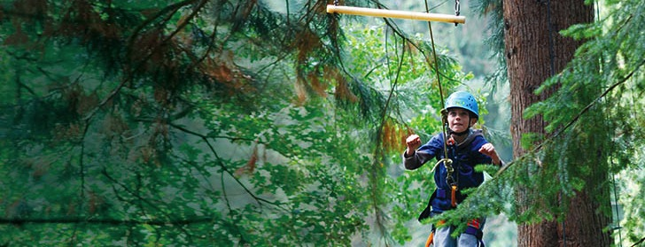

Multi-Activity
4 action-packed adventure activity sessions per day
Evening entertainment
Great for personal development & confidence building
Increases motivation & appetite for learning
Guides work with groups
Notes:
Benefits of a multi-activity course include:
- improved self confidence
- improved team-building skills
- better peer group relationships
- raised self esteem
- increased motivation.

Slide 17
Adventure activities
Abseiling
Aeroball
Archery
Blokarting
Bodyboarding
Challenge Course
Climbing
Coastal Walk
Fencing
First Aid
High Ropes Course
Kite Flying
Mountain Biking
Orienteering
Problem Solving
Quad Biking
Rifle Shooting
Sensory Trail
Sports and Team
Games
Street Surfing
Survivor
Trapeze
Zip Wire
Notes:
The activities shown offer individual as well as team challenges
Activities are designed to encourage new skills and develop existing ones
Specific activities can be requested (though not guaranteed) and the programme is discussed on arrival at the centre

Slide 18
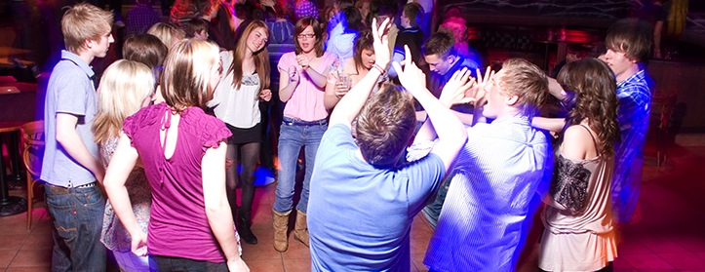
Evening entertainment
Ambush
Campfire
Capture the Flag
Cluedo
Disco
Passport to the World
Quiz
Robot Wars
Splash
Wacky Races

Slide 19
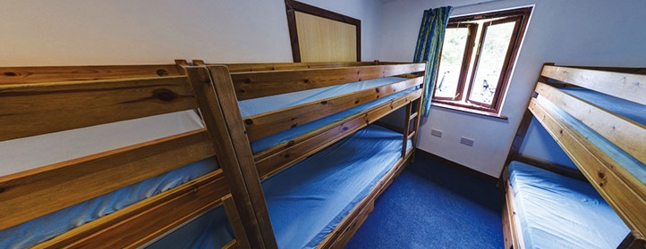
Accommodation
Main House – rooms with bunk beds sleep 6-16
Toilets and showers close by
Notes:
The centre can accommodate 156 guests at a time with accommodation in the main house
Teachers are usually accommodated in twin or triple rooms with en suite and hot drink facilities
All rooms are lockable (party leader given master key)
All exterior doors and gates are locked at night but can be opened from the inside in an emergency without the need for unlocking
A PGL staff member is available on duty throughout the night (contactable by phone)
The extensive facilities (other than activity bases) are available to your group during free time

Slide 20
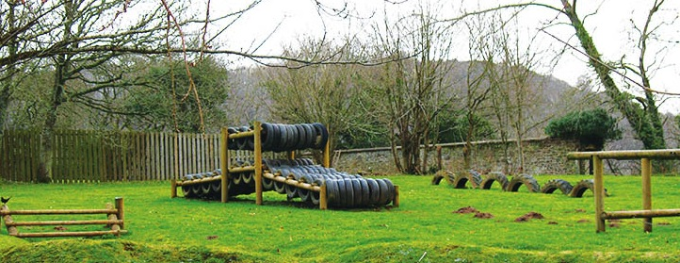
Facilities
Indoor games areas
On-site adventure activities
Disco
Shop

Slide 21
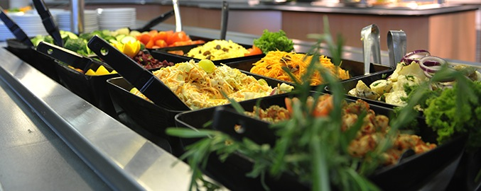
Catering and dietary needs
3 nutritious, balanced meals per day
Self-service salad bar
Vegetarian option
Special diets catered for by prior arrangement
Sample menus available online: www.pgl.co.uk
Notes:
We continually invest in healthy menus with freshly cooked ingredients obtained from fully traceable audited suppliers
Processed food is avoided and meals meet Local Authority guidelines
There will be hot and cold options available at every meal
At lunch and dinner the buffet includes a salad bar and mixed fruit basket plus hot and cold drinks
Our caterers can deal with most dietary requirements but please ensure the party leader is aware of any dietary requirements well in advance
More food is always available if required

Slide 22
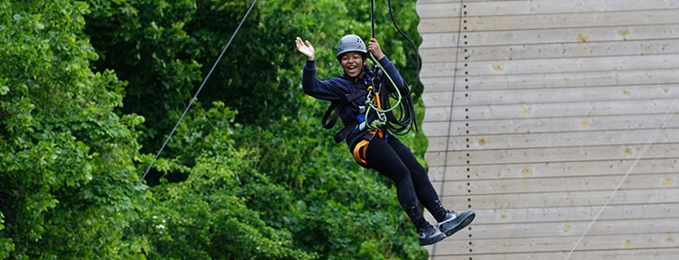
FAQs
Insurance
What to take – kit list
Valuable items – best left at home
Pocket money – how much to take
Electrical appliances – must be safe
Deodorants – roll-on only please
Contacting your child
Notes:
PGL includes extensive insurance cover organised through travel insurance specialists (see separate insurance details)
Please limit luggage to one case/bag per person and one item of hand luggage for carrying food etc. on the journey
The kit list is provided on the Parent Pupil Information Leaflets however we would like to stress that:
Old, casual clothes are recommended
Pack more clothes if it is likely to be wet weather
All clothing should be marked with the student’s name and school
Brand new and expensive items (such as mobile phones) should be left at home
Pocket money - It is very much up to you. As a guide, a figure of £5.00 - £10.00 per day would be reasonable
Electrical appliances - Guests are responsible for the safety of any electrical appliances brought to centre. The Centre Manager reserves the right to ask for appliances not to be used if they appear to be unsafe
Deodorants - It is advised that children bring roll-on deodorants rather than aerosol deodorants as these can often set off fire alarms
Laundry facilities - There are limited laundry facilities on centre and therefore they can only be used in an emergency
Contacting your child - Parents are asked not to call the centre except in an emergency. The centre telephones are business lines and may be needed for emergencies

Slide 23
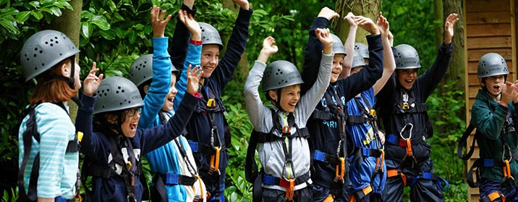
Thank you for listening
Any questions?
Notes:
Questions?

Slide 24

Thank you for coming
We are looking forward to a fantastic year with our fabulous
Owl class!
Do you have any questions?

